Slide 1
May 2016 Safety Focus Extra

Slide 2
What is 5S and why do we want to do it?
Simple but highly effective set of techniques that help organize and remove excess from your work environment through:
Better workplace organization
Visual communication and management
Standardization
General cleanliness
An unclean environment contains hidden risks for workers and equipment.

Slide 3
Who developed 5S?
Originally developed by Hiroyuki Hirano for manufacturing companies in Japan, the principles of 5S translate well into the laboratory.
Almost any workplace environment will benefit from the structure and efficiency that this model provides.
The 5S model has 5 principles: Sort, Set in Order, Shine, Standardize and Sustain.

Slide 4
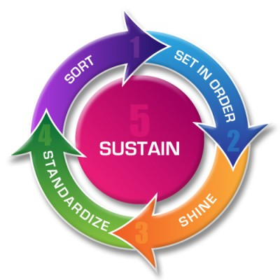
Principles of 5S

Slide 5
SORT
Definition: Examining the contents in an area and removing unnecessary items.
What to do: Do not keep anything that is unnecessary to your workplace. Ex: Old samples that are no longer relevant, chemicals that have expired, equipment and electronics that are broken or obsolete. Remember to “sort” through all drawers and cabinets.
Why: Storage space for necessary items and usable workspace are both increased. Important items are more easily found.
Problems avoided: Clutter in the workplace, time wasted looking for items, lack of storage space and usable work surfaces.

Slide 6
SET IN ORDER
Definition: Arranging items for easy and efficient access in their place of use.
What to do: Place tools or other items near the equipment with which it is associated. Put most frequently needed items in quickly accessible areas. Store infrequently used items in longer term storage areas. Keep related items together in the same place.
Why: Items become easier to find. Readily discernable when replacement items are necessary. Improved efficiency while working.
Problems avoided: Waste in time searching, excess inventory ordering.

Slide 7
SHINE
Definition: Cleaning everything in the work area.
What to do: Sweep up debris on floors, wipe up spills within hoods and on work surfaces, clean equipment thoroughly when finished using it, throw trash away.
Why: Cleaning helps ensure that the area & equipment are maintained in working order, and reduces the potential for contamination.
Problems avoided: Safety issues, low morale, costs for equipment maintenance.

Slide 8
STANDARDIZE
Definition: Using identical items and / or creating standard practices
What to do: Make items and practices uniform wherever possible within the group. Write Standard Operating Procedures for equipment and routine activities.
Why: Commonality helps improve visibility of when something is out-of-place, or performed in an incorrect and potentially unsafe manner. Reduces unnecessary exceptions to the rules.
Problems avoided: Loss of knowledge during transfer, uncertainty on activities and items within the laboratory.

Slide 9
SUSTAIN
Definition: Maintaining the improvements brought through the first four S principles.
What to do: Set aside 5 minutes everyday to clean your workspace and put everything away properly. Once a month, re-evaluate the entire laboratory for Sort, Set in Order, Shine, and Standardize, and address issues as they are found.
Why: The improvements will not last without investing time in their upkeep.
Problems avoided: Safety issues, clutter, chaos & bad communications.

Slide 10
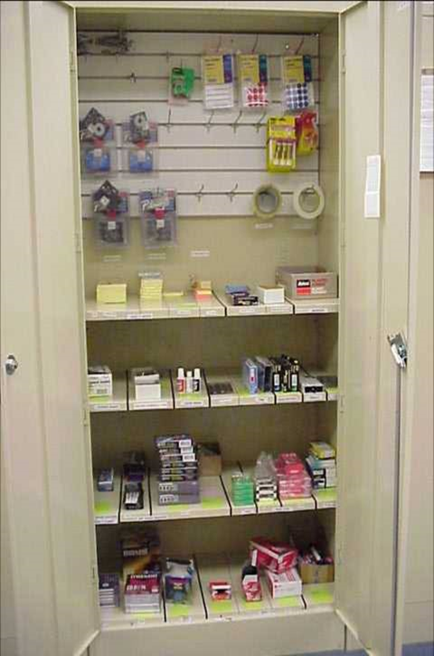
Simple Example: Cluttered to Organized

Slide 11
What’s in it for you?
5s makes your lab safer and more pleasant to do research.
Together, cleaning and organizing the lab builds teamwork.
Increases efficiency, improves research, decreases stress.
Prepares you for future employment.
Reduces research costs, by maintaining equipment properly and maintaining proper equipment inventory.

Slide 12
For further information contact the CPSPE Safety Office x 7478.

